Slide 1

Eager / Lazy / Explicit
Loading
In ASP.NET MVC and EF

Slide 2
Three common loading patterns are used within the EF (Entity Framework) Core:
Lazy Loading:
  Transparent loading of related data when accessed
Eager Loading:
  Loading related-data upon initial query
Explicit Loading:
  Loading related-data at a later time

Slide 3
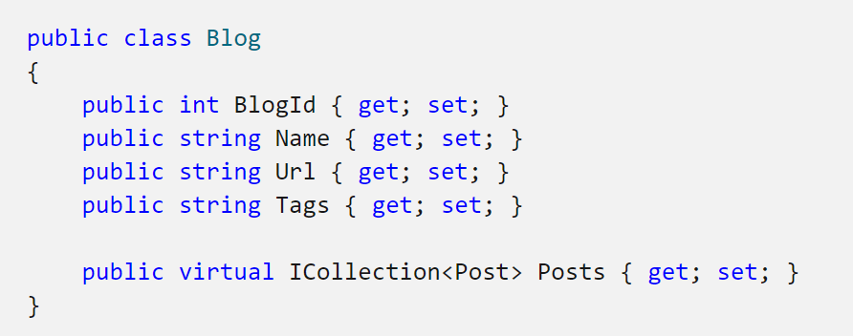
Lazy Loading
– (The previously-defacto Practice from Entity Framework 6.0)
Lazy Loading is delaying the loading of related data, until you specifically request for it. It is the opposite of eager loading
Lazy loading is the process whereby an entity or collection of entities is automatically loaded from the database the 1ST time that a property is referring to the entity
  For example, when using the Blog entity class defined on the right, the related Posts will be loaded the first time the Posts navigation property is accessed
A child entity is loaded only when it is accessed for the 1st time. It simply delays the loading of the related data, until you access it (it does not reload).

Slide 4
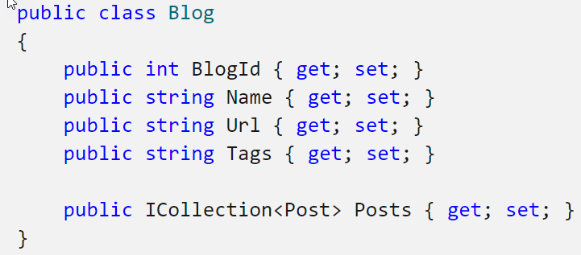

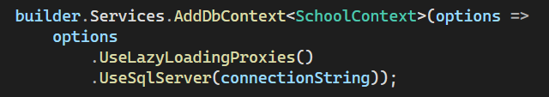
How to Turn on Lazy Loading?
Enabling Lazy Loading required very little work in previous version(s) of the Entity Framework (EF6) – all you had to-do was add the virtual keyword to your Navigation properties and presto! – these properties were automatically loaded simply by accessing them.
EF Core requires a few extra steps:
  Installing Nuget Package
  Configuring the DbContext
  to use the
  Lazy Loading Proxies

Slide 5
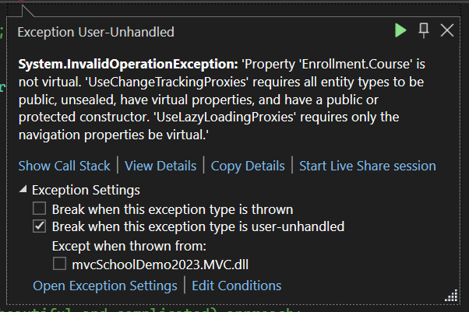
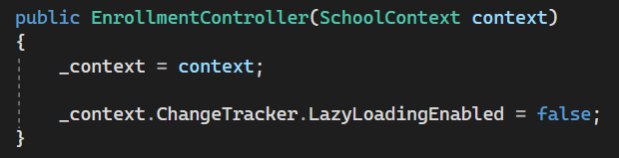
How to Turn off Lazy Loading
(for specific situations)
Disabling Lazy-loading is not as simple as just removing virtual from navigation properties (because this will cause the following error):
Instead – we need to specifically manage the state of the Lazy-loading within the Controller class, either for the class as a whole or specific workflows by explicitly disabling the DbContext instance ChangeTracker.LazyLoading property
(Depending on where this is invoked, it can have specific/broad impact)

Slide 6
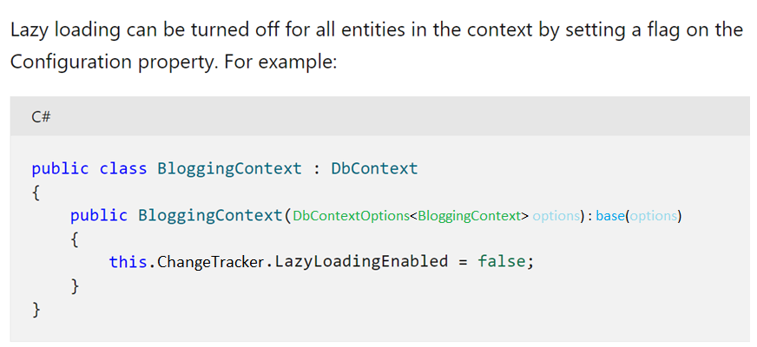
How to Turn off Lazy Loading
(for all entities)

Slide 7
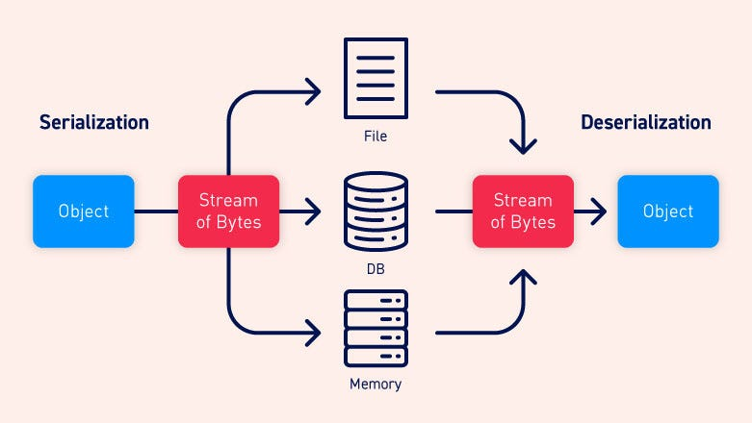
When NOT to use lazy loading?
Lazy loading and serialization do not mix well…if you aren’t careful when serializing ‘you can end up querying for your entire database just because lazy loading is enabled. ’
It is therefore a good practice to turn lazy loading off before you serialize an entity.
  https://learn.microsoft.com/en-us/ef/core/querying/related-data/
  https://docs.microsoft.com/en-us/ef/ef6/querying/related-data
  Serializing?
  Serialization is the process of converting an object into a stream of bytes to store the object or transmit it to memory, a database, or a file (one of the main intents/workflows of JSON).
  Its main purpose is to save the state of an object in order to be able to recreate it when needed. The reverse process is called deserialization
  https://docs.microsoft.com/en-us/dotnet/csharp/programming-guide/concepts/serialization/

Slide 8
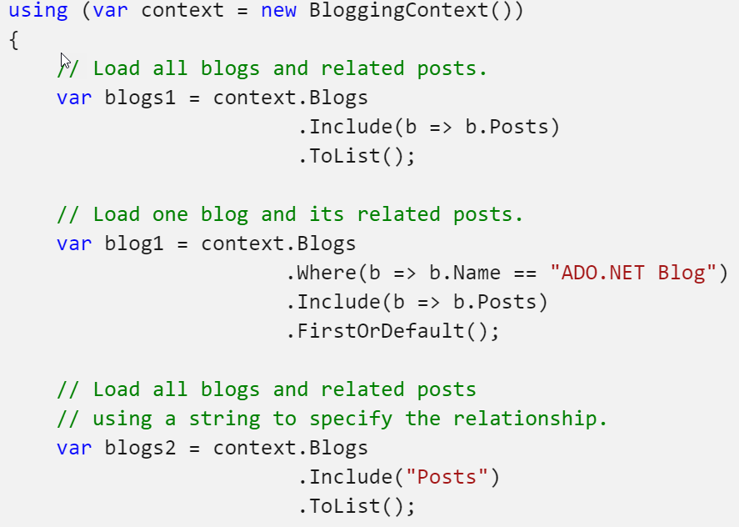
Eager Loading
Eager loading means that the related data is loaded from the database as part of the initial query.
  It helps you to load all your needed entities at once; i.e., all your child entities will be loaded at single database call.
Eager loading is the process whereby a query for one type of entity also loads related entities as part of the query, so that we don't need to execute a separate query for related entities.
Eager loading is achieved using the Include(…) method.

Slide 9
Explicit Loading
There are several important workflows that require Explicit Loading:
  After turning Lazy Loading off for an Entity
  Re-attaching entities (and Navigation properties) when returning to the controller via a [HttpPost] method
Explicit Loading is performed for the entities by explicitly calling the Load(…) method for the related entities.
There are several ways of using the Load(…) method:
  via the Reference(…) method (to load a single navigation property) and
  The Collection(…) method(to load collections), as shown below.
  User usr = dbContext.Users.FirstOrDefault(a => a.UserId == userId);
  dbContext.Entry(usr).Reference(usr => usr.UserDetails).Load();
  dbContext.Entry(usr). Collection(usr => usr.UserProjects).Load() ;

